Slide 1
Module 4
VLAN and Port Configuration
Notes:
Setting up Virtual LANs (VLANs) on the switch eases many time-consuming tasks of network administration while increasing efficiency in network operations.
This section will describe the concept of VLANs and discusses how to implement VLANs on the Extreme switches.

Slide 2
Module Objectives
Describe the switch ports, parameters its configuring using the CLI commands
Define the load sharing feature and its benefits
Define VLAN in an overview
Describe VLAN tagging and its advantages
Distinguish between VLAN types - port-based, tagged, protocol-based, MAC-based and vMANs
Describe how to configure Vlans Port Load Sharing using CLI commands
Perform Lab Exercises
Summary
Notes:
We are going to discuss the different types of ports supported in the Switch, including the configurable port parameters. We will then proceed to discuss the different CLI commands to do Port Configuration.
The next major discussion will be about VLANs in an Overview, the types of VLANs, and how to configure for them.

Slide 3
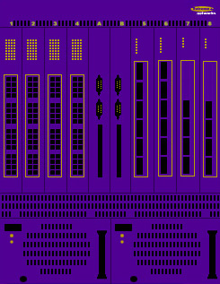
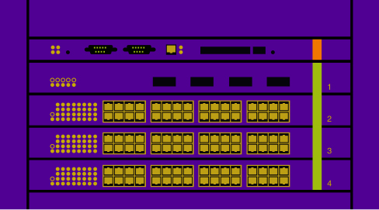
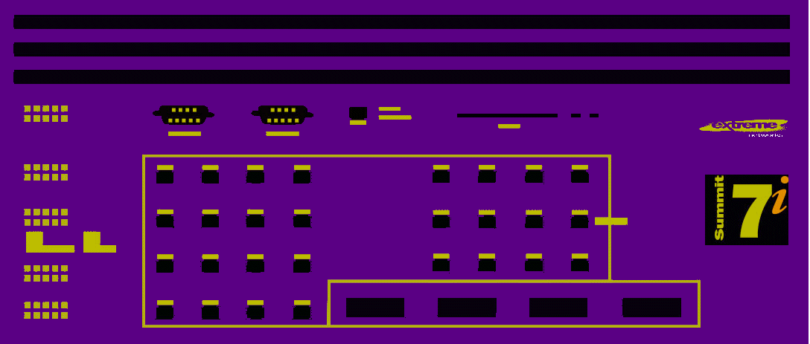
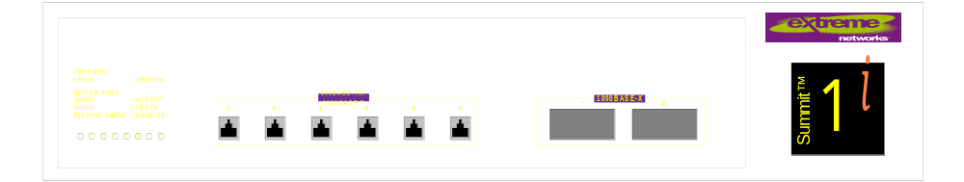
Switch Port Types
10/100 Base-T (Ethernet and Fast Ethernet)
100Base-T (Fast Ethernet)
100Base-FX (Fast Ethernet on Fiber)
  MT-RJ-based
100/1000Base-T (Fast and Gigabit Ethernet)
1000Base-T (Gigabit Ethernet)
1000Base-F (Gigabit Ethernet over Fiber)
1000BASE-X
  SX, LX or LX-70 GBIC-based
  MT-RJ-based GBIC-based
Notes:
Depending on the switch configuration, a Summit, Alpine or Black Diamond switch is capable of supporting a variety of port types listed above.

Slide 4
Configurable Port Parameters
Enabling and disabling Extreme Switch ports
Configure port speed and Duplex setting
  Disable Auto-Negotiation for Gigabit port
Enabling Jumbo frames on ports
Enabling Load Sharing on groups of ports
  Verifying Load sharing configuration
Configure for Port-Mirroring
Enabling EDP
Notes:
This discussion will be describing how to configure ports on the Summit switch. For information on how to configure ports on the Black Diamond, refer to the ExtremeWare Software User Guide.
Ports on the Summit switch can be configured in the following ways:
Enabling and disabling individual ports
Configuring the port speed (Fast Ethernet ports only)
Configuring half- or full-duplex mode
Disabling Auto-negotiation for Gigabit port
Creating load-sharing groups on multiple ports
Configuring a port to connect to the Summit Virtual Chassis
Configuring QoS on a port-by-port basis
We can configure for loadsharing, ability to ganged ports into virtual pipes or trunks.

Slide 5
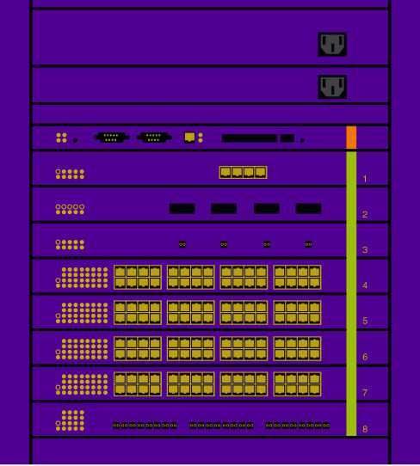
Configurable Port Parameters
BlackDiamond and Alpine Switches
All configurable parameters discussed apply
When configuring port numbers, use this nomenclature:
  SLOT : PORT NUMBER
  Example: 2:4
    Represents port 4 in an I/O module installed in Slot 2
Configure/use the type of I/O module installed per slot using CLI commands
  config slot <slot number> module [ f32f | f48t | g4x | g8x ]
    Modules shown may vary on type of switch.
  clear slot
  show slot
Notes:
On the BlackDiamond or Alpine switch, the port number is a combination of the slot number and the port number. The nomenclature for the port number is as follows:
slot: port
For example, if an I/O module like the G4X that has a total of four ports
You can also use wildcard combinations (*) to specify multiple BDs or Alpine slot and port combinations.
Reference the ExtremeWare Software User Guide 6.1+ for more details about configuring the Alpine and BlackDiamond switches.
The three commands config slot…clear slot and show slot are applicable only for the chassis-based switches.

Slide 6

Enabling and Disabling Ports
All ports are enabled by default
Use the CLI command:
  [enable | disable] port <port number>
Even if a port is disabled, the link remains enabled for diagnostic purposes
Notes:
By default, all ports are enabled. To enable and disable one or more ports, use the command:
[ Enable |disable ] port <port number>
Even though a port is disabled, the link remains enabled for diagnostic purposes

Slide 7
Auto-negotiation, Speed and Duplex
Auto-negotiation is on by default
  For determining the port speed and duplex setting per port
Duplex and speed setting can be manually configured for 10/100 Mbps ports
Gigabit ports are statically set to 1 Gbps
  speed cannot be modified
  Duplex setting can be manually configured
Flow control for Gigabit ports is supported
  Enabled or disabled as part of Auto-negotiation
    disabled if auto-negotiation is turned OFF
    enabled if auto-negotiation is turned ON
Notes:
The Switch is configured to use auto-negotiation to determine the port speed and duplex setting for each port
Fast Ethernet ports can be manually configured for either 10Mbps or 100Mbps
Fast Ethernet ports can be configured for half- or full-duplex operation
Gigabit Ethernet ports are statically set to 1 Gbps/Full Duplex and their speed cannot be modified.
10BASE-T and 100BASE-T ports can connect to 10/100Base-T networks

Slide 8
Turning Off Auto-Negotiation - GbE
In certain interoperability situations, it may be necessary to turn off auto-negotiation on a Gigabit Ethernet port.
The command to turn OFF auto-negotiation is:
  config ports <slot:port> auto off duplex full
    You still need to specify the duplex setting as FULL even though a GbE port runs only on full duplex.
Notes:
In certain interoperability situations, it is necessary to turn auto-negotiation off on a Gigabit Ethernet port. Even though a Gigabit Ethernet port runs only at full duplex and gigabit speeds, the command that turns off auto-negotiation must still include the duplex setting.
Example of turning auto-negotiation off for port 49 (a Gigabit Ethernet port);
config port 49 auto off duplex full

Slide 9
Jumbo Frames
Extreme i-based switches support switching and routing of Jumbo frames at wire speed on all ports
  These are larger than Ethernet Frame’s 1522 bytes plus CRC
To enable support
  You must configure the maximum MTU size of jumbo frame allowed by the switch ranging from 1523 - 9216
    config jumbo-frame size <jumbo_frame_mtu>
  Enable support on ports that will carry jumbo frames
    enable jumbo-frame ports [ all | <ports list> ]
Notes:
Ethernet frames that are larger than 1523 bytes, including four bytes used for the Cyclic Redundancy Check (CRC) are called Jumbo Frames. Extreme switches of the I-series chipset support switching and routing of jumbo frames at wire-speed on all ports.
Jumbo frames are used between end-stations that support larger frame sizes for more efficient transfers of bulk data. Both endstations involved in the transfer must be capable of supporting jumbo frames. The switch does not perform IP fragmentation, or participate in MTU negotiation on behalf of devices that do not support jumbo frames.
NOTE:
Some network interface cards (NICs) have an MTU size that does not include the 4-byte CRC. You must ensure that the NIC MTU size is at or below the maximum MTU size configured on the switch. Frames that are larger the the MTU size configured are dropped at the ingress port.

Slide 10
Port Load Sharing Feature
Supported between all Extreme switches only
Allows increase bandwidth and resilience
  by using a group of ports to carry traffic in parallel between switches
The sharing algorithm allows the switch to use multiple ports as a single logical port
If a port fails in a load-sharing port group
  Traffic is redistributed to the remaining ports
  If the port comes back, traffic is redistributed to include it
Must be enabled on both ends of the link
  To prevent network loops
Notes:
Load sharing allows you to increase bandwidth and resilience between Extreme switches by using a group of ports to carry traffic in parallel between switches. The sharing algorithm allows the switch to use multiple ports as a single logical port. For example, VLANs see load-sharing group as a single logical port. The algorithm also guarantees packet sequencing between clients.
If a port in a load-sharing group fails, traffic is redistributed to the remaining ports in the load-sharing group. If the failed port becomes active again, traffic is redistributed to include that port.
Load sharing must be enabled on both ends of the link, or a network loop will result.
Load-sharing is most useful in cases where the traffic is transmitted from the switch to the load-sharing group is sourced from an equal or greater number of ports on the switch. For example, traffic transmitted to a 2-port load-sharing group should originate from a minimum of two other ports on the same switch.
This feature is supported between all Extreme switches, and may also be compatible with third-party “trunking” or sharing algorithms. Note that BlackDiamond trunks cannot span data modules.

Slide 11
Load-Sharing Algorithms
Port-based (default)
  Uses the ingress port to determine which member port to forward traffic out of the switch
Address-based (recommended)
  Uses addressing information based on packet protocol, as follows:
    IP packets
      Uses source/destination MAC and IP addr, and TCP port no.
    IPX packets
      Uses source/destination MAC addr, and IPX network identifiers
    All other Packet - Uses source/destination MAC addr
Round-robin
  Used when the switch receives a stream of pets, it forwards one packet out of each physical port in the load-sharing group
Notes:
Load sharing algorithms allow you to select the distribution technique used by the Load-sharing group to determine the output port selection.
It is not intended for use in predictive traffic engineering.
You can configure the three LS algorithms above.
Port-based - Uses the ingress port to determine which member port to forward traffic out of the switch
Address-based - Uses addressing information based on packet protocol, as follows:
IP packets - Uses source/destination MAC and IP addr, and TCP port no.
IPX packets - Uses source/destination MAC addr, and IPX network identifiers
All other Packet - Uses source/destination MAC addr
Round-robin
Used when the switch receives a stream of pets, it forwards one packet out of each physical port in the load-sharing group
NOTE: Using the R-R algorithm, packet sequencing between clients is not guaranteed.
If you do not explicitly select an algorithm, the port-based scheme is used by as default algorithm, however, the Address-based load sharing algorithm is RECOMMENDED because it has a more even distribution.

Slide 12
Load Sharing Rules
First port in the load-sharing group is configured to be the “master” logical port
  Used as reference port for port configuration.
  Becomes a logical port representing the entire port group
For BlackDiamond I-based modules
  One group can contain up to 8 ports
  Ports in the group must be on the same I/O Module
  Ports in the group do not need to be contiguous
For non-I based switches,
  Ports are divided into groups of two or four
  Ports in a load-sharing group must be contiguous
  Only Port-based algorithm applies
Notes:
To setup the Summit to load share among ports, you must create a load-sharing group of ports. Load-sharing groups are defined according to the following rules
Ports on the switch are divided into groups of two or four. You can load-share 2 or 4 links
Ports in a load-sharing group must be contiguous
Determine the valid port combinations by following the outlined boxes in the next slide.
The first port in the load-sharing group is configured to be the “master” logical port.This is the reference port used in configuration commands. It can be thought of as the logical port representing the entire port group.
Open implementation - compatible with Sun Quad fast Ethernet card and supports Cisco EtherChannel

Slide 13
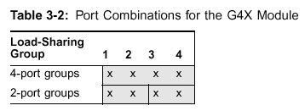
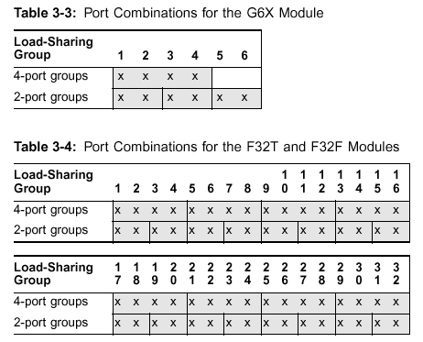
Possible BD Load-Sharing Port Groups
Notes:
The available port combinations for the BlackDiamond modules are shown.
To define a load-sharing group, you assign a group of ports to a single, logical port number. To enable or disable a load-sharing group, use the following commands:
enable sharing <master_port> grouping <portlist>
disable sharing <master_port>

Slide 14
Configuring for Load Sharing
Create a load-sharing group of ports, use the CLI command:
  Enable sharing <master_port> grouping <portlist> [ <cr> | algorithm [ address-based | port-based | round-robin ]
  Example: Enable sharing 3:9 grouping 3:9 – 3:12

Slide 15
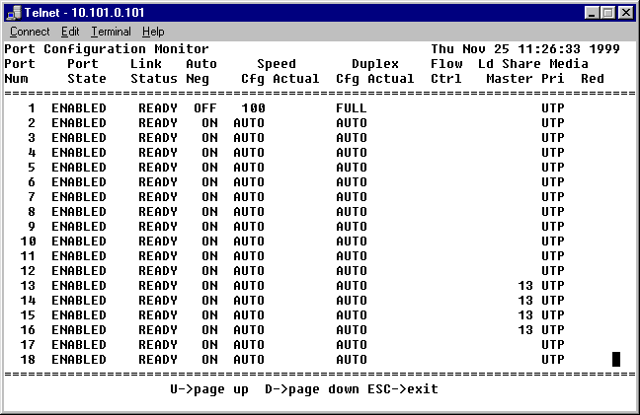
Verifying Load Sharing Configuration
Execute the CLI command:
  Summit # show ports configuration
Logical Master Port Number
Notes:
The screen output resulting from the CLI command - show ports configuration, indicates which ports are involved in load sharing and the master logical port identity.

Slide 16
Port-Mirroring Feature
Configures the switch to copy all traffic associated with one or more ports
  The monitor port can be connected to a network analyzer or RMON probe for packet analysis
Uses a traffic filter that copies a group of traffic to a monitor port and can be defined based on:
  Physical port
  VLAN
  Virtual Port
Up to 8 mirroring filters and one monitor port can be configured
Frames that contain errors are not mirrored!
Notes:
Port-mirroring configures the switch to copy all traffic associated with one or more ports to a monitor port on the switch.The monitor port can be connected to a network analyzer or RMON probe for packet analysis. The switch uses a traffic filter that copies a group of traffic to the monitor port.
The traffic filter can be defined based on one of the following criteria:
Physical port - All data that traverses the port, regardless of VLAN configuration, is copied to the monitor port.
VLAN - All data to and from a particular VLAN, regardless of the physical port configuration, is copied to the monitor port.
Virtual port - All data specific to a VLAN on a specific port is copied to the monitor port.
Up to 8 mirroring filters and one monitor port can be configured on the switch. Once a port is specified as a monitor port, it cannot be used for any other function.
Frames that contain errors are not mirrored.
NOTE:
On non-I chipset switches, mirrored frames that are transmitted from the switch do not contain 802.1Q VLAN tagging information.

Slide 17
Port-Mirroring CLI Commands
Dedicate a port to be the mirror output port :
  enable mirroring to <port number> [tagged untagged]
  Example: enable mirroring to port 7:3 untagged
Add a single mirroring filter definition from a VLAN, physical port or vlan/port combination:
  config mirroring add [ports | vlan | <vlan_name>] <port number>
  Example:
    config mirroring add port 7:1
    config mirroring add port 8:1 vlan default
Verify and display port-mirroring configuration
  show mirroring
Notes:
Port-mirroring commands are described as follows:
enable mirroring to <port> : Dedicates a port to be the mirror output port
config mirroring add ports vlan <vlan name> <hex octet>
Adds a single mirroring filter definition. Up to eight mirroring definitions can be added. You can mirror traffic from a MAC address, a VLAN, a physical port, or a specific VLAN/port combination.
config mirroring delete ports vlan <vlan name> <hex octet>
Deletes a particular mirroring filter definition, or all mirroring filter definitions.
disable mirroring : Disables port-mirroring
show mirroring : Displays the port-mirroring configuration
The following example selects port 3 as the mirror port, and sends all traffic coming into or out of the switch on port 1 to the mirror port:
enable mirroring to port 3
config mirroring add port 1
The following example sends all traffic coming into or out of the switch on port 1 and the VLAN “default” to the mirror port.
Config mirroring add port 1 vlan default

Slide 18
Extreme Discovery Protocol - EDP
Utilized for gathering information about neighbor Extreme switches.
Extreme switches use it to exchange topology information with each other
Communicated data using EDP include the switch:
  MAC address (Switch ID)
  Software version information
  IP address
  VLAN-IP information
  Switch Port number
EDP
Notes:
The Extreme Discovery Protocol is a Layer 2 protocol and is Extreme proprietary. It rides over Ethernet. It is enabled by default.
When running on a normal switch port, EDP is used by the switches to exchange topology information with each other.
Information communicated using EDP includes the following:
Switch MAC address (Switch ID)
Switch software version information
Switch IP Address,
Switch VLAN-IP information,
Switch port number

Slide 19
EDP Configuration
EDP is enabled by default.
Enable/disable the generation and processing of EDP messages on one or more ports with Default is enabled.
  enable/disable edp ports [all | <port number]
Display EDP information using the CLI command
  show edp

Slide 20
CLI Commands for Port Configuration
enable/disable learning ports
enable/disable ports
config port auto on/off
show port <port number>
show ports collision
show ports configuration
show ports info
show ports packet
show ports qosmonitor
show ports rxerrors
show ports stats
show ports txerrors
show ports utilization
Notes:
Other CLI Commands for Port configuration is listed above. You will learn how to utilize each of the commands when you have your hands-on exercises on the switch.
enable/disable learning ports ⬅ shown in the next slide. All other commands is self-explanatory.
enable/disable ports
config port auto on/off
show port <port number>
show ports collision
show ports configuration
show ports info
show ports packet
show ports qosmonitor
show ports rxerrors
show ports stats
show ports txerrors
show ports utilization

Slide 21
CLI Command - enable/disable learning ports
enable learning ports <port number>
disable learning ports <port number>
Enables and disables MAC address learning on one or more ports.
If learning is disabled, only broadcast traffic and packets destined to permanent FDB entries on that port are forwarded.
Default setting is enabled.
Notes:
This concludes the discussion on Extreme Ports Configuration. We are now ready to learn about the Extreme switch Layer 2 function and VLAN operations.

Slide 22
VLAN Overview and Configuration
Notes:
Setting up Virtual LANs (VLANs) on the switch eases many time-consuming tasks of network administration while increasing efficiency in network operations.
This section will describe the concept of VLANs and discusses how to implement VLANs on the Extreme switches.

Slide 23
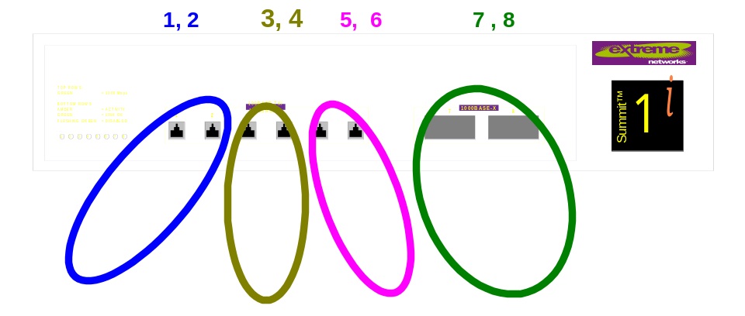
What are VLANs?
Virtual Local Area Networks
A collection of devices that communicate as if they were on the same broadcast domain.
Each VLAN forms an independent broadcast domain
They are logical interfaces in all Extreme switches
They have one or more switch ports as members
Their configuration and operation is integral to the overall function of the Extreme switch
Notes:
The term “VLAN” is used to refer to a collection of devices that communicate as if they were on the same broadcast domain or physical LAN. Any set of ports (including all ports on the switch) is considered a VLAN. VLAN segments are not restricted by the hardware that physically connects them. The segments are defined by flexible user groups you create with the CLI - command-line interface.
VLANs are treated as a difference broadcast domains, each one of the VLANs have to be configured with an IP address if you want to manage it. Depends on the configuration and how you get there.
The logical interface in all Summit switches is the Virtual LAN, or VLAN. The term is used to refer to a collection of devices that communicate as if they were on the same physical local area network.
A VLAN can be comprised of one or more ports, and a port may participate in one or more VLANs.

Slide 24
VLAN Benefits
Help to control traffic
Provide extra security
  Only devices belonging to the same vlan will see each others broadcast.
Ease the change and movement of devices
Marketing
Operations
Finance
Engineering
Notes:
Implementing VLANs on your networks has the following advantages
VLANS help to control traffic
With traditional networks, congestion can be caused by broadcast traffic that is directed to all network devices, regardless of whether they require it. VLANs increase the efficiency of you network because each VLAN can be set up to contain only those devices that must communicate with each other.
VLANS provide extra security
Devices within each VLAN can only communicate with member devices in the same VLAN. If a device in VLAN Marketing must communicate with devices in VLAN Sales, the traffic must cross a routing device.
VLANs ease the change and movement of devices
With traditional networks, network administrators spend much of their time dealing with moves and changes. If users move to a different sub-network, the addresses of each sub-station must be updated manually.
For example, with a VLAN, if an end-station in VLAN Marketing is moved to a port in another part of the network, and retains its original subnet membership; you must only specify that the new port is in VLAN Marketing .

Slide 25
VLAN in Extreme Switches
Each Summit i-series and Alpine switch can have a maximum of 3000 VLANs
  Includes all vlans, including sub-vlans, super-vlans, etc.
  2 Vlans are pre-configured – Default and MacVlanDiscover
Each BlackDiamond Switch can have a maximum of 3000 VLANs in all i-series systems
  1024 for mixed non-i-series and i-series systems
  2 Vlans are pre-configured – Default and MacVlanDiscover
Notes:
Each Summit Switch can have a maximum of 256 VLANs, 255 of them can be configured by the user. There is 1 VLAN already pre-configured named “default”
VLAN default is discussed further in the next slide.

Slide 26
VLAN – Default
Comes pre-configured on all switches
Contains all the switch ports as members on new or initialized switch (untagged)
Has an internal VLANid of “0001”
Can be renamed but cannot be deleted
  VLAN names are not case sensitive
  vlan DEFAULT
Notes:
The switch ships with one default VLAN that has the following properties:
Comes pre-configured on all switches
Contains all the switch ports as members on new or initialized switch (untagged) ***Note: Because of this, as soon as you create a new vlan and try to add a port (untagged) you will get a system error:
* Summit1iTx:13 # con test add po 1
ERROR: There is a protocol conflict with adding port 1 untagged to
vlan "test". Either add this port as tagged or assign another
protocol to this vlan
Only 1 port
Has an internal VLANid of 1
Can be renamed but cannot be deleted
VLAN names are not case sensitive

Slide 27
VLAN - MacVlanDiscover
A pre-configured MAC-based Vlan
Found only on all i-series switches
No member switch ports
Has an internal VLANid of “4095”
Cannot be deleted, renamed nor configured or shown as a Vlan
More on this later

Slide 28
Renaming Vlans
To rename an existing vlan, use the CLI command
  config vlan <old_name> name <new_name>
Once the default vlan is renamed, it cannot be changed back to the name “default”
You can create a new VLAN named “default” after renaming it.
You cannot change the MacVlanDiscover VLAN name
Example:
  config default name new_default

Slide 29
Types of VLANs
Port-based (Untagged) Vlan
802.1Q Tagged Vlan
Protocol-based Vlan
  Ethernet, LLC SAP, or LLC/SNAP Ethernet protocol type
  Treated like a Tagged Vlan
MAC-based Vlan (MAC address)
A combination of any of the above
Notes:
VLANs can be created on the switch according to the following criteria.
Port-based (Untagged) Vlan
802.1Q Tagged Vlan
Protocol-based Vlan
Ethernet, LLC SAP, or LLC/SNAP Ethernet protocol type
Treated like a Tagged Vlan
MAC-based Vlan (MAC address)
A combination of any of the above
You need to provide a physical connection between the switches when you configure Vlans, if you want each one of the Vlan, you need to be connected physically, even though they belong to the same broadcast domains.
In order for a port to participate in more than 1 VLAN, you have to isolate the traffic - reason being is that there are several different types of traffic.
How do you know the type of traffic going through is red or blue?
This introduces us to going into TAGGING that allows us to carry traffic into multiple broadcast domains going to 4-61.

Slide 30
Port-Based VLANs
Also known as “untagged” Vlans
Port members are untagged
A port can only be a member of one port-based VLAN
VLAN Default is an example
  config default delete ports all
  Finance
  3,4
  1,2
  7,8
  Marketing
  Engineering
Notes:
Also known as “untagged” Vlans
Vlans that have not been configured with a TAG or VLANid
Port members are untagged
Ports that were configured (added) to the vlan untagged
A port can only be a member of one port-based VLAN
Any VLAN created as port-based or untagged cannot be configured with an untagged port already a member of an untagged Vlan.
VLAN Default is an example
config default delete ports all

Slide 31
Configuring Port-based VLAN
Create Port-based Vlan using the CLI command
  create vlan <vlan_name>
  Example:
    create vlan blue
    create vlan green
    create vlan pink
Configure Vlans by adding ports using CLI
  configure <vlan_name> add ports <port_list>
  Example:
    config blue add port 1,2
    config green add port 7,8

Slide 32
Configuring Port-based VLAN
What if…
When configuring a vlan, you get an error:
Summit1iTx:17 # config vlan test add port 1
ERROR: There is a protocol conflict with adding port 1 untagged to
vlan "test". Either add this port as tagged or assign another
protocol to this vlan
And upon examining existing vlans, we find this:
* Summit1iTx:18 # sh vlan default
VLAN Interface[0-200] with name "Default" created by user
Tagging: 802.1Q Tag 1
IP: Waiting for bootp reply.
STPD: Domain "s0" is not running spanning tree protocol
Protocol: Match all unfiltered protocols.
Loopback: Disable
Rate Shape: Disable
QosProfile: QP1
Ports: 8. (Number of active ports=0)
Untag: 1 2 3 4 5 6 7 8
Notes:
Recall that in an Extreme switch: A port can only be a member of one port-based VLAN
The error above indicates that 1 is already a member of a port-based vlan other than TEST, and to get around it, you can either make the vlan TEST a TAGGED vlan or a protocol-based vlan (which we will be discussing in a moment).
HOW DO YOU WORK AROUND IT?
Because VLAN Default initially contains all the switch ports as members (untagged), this will error will always appear each time you create and configure a port-based vlan and add a port untagged.
SOLUTION: Delete all ports on VLAN default before attempting to create and configure new port-based vlans.
The command to initiate is the
config default delete ports all

Slide 33
Lab5
Port-Based VLAN L2 Configuration
Create and configure port-based Vlans on each switch in class.
Color | VLAN Name | Ports | Port Type
Blue | Hawaii | 1-2 | copper
Khaki | Maui | 3-4 | copper
Redish | Kauai | 5-6 | copper
Green | Oahu | 7-8 | fiber
Notes:
In this lab exercise, each student or pair of students will work on a Summit1i switch or equivalent. If you are working on a new or initialized switch (I.e. the “unconfig switch all” CLI command has just been issued), you need to do this first:
config vlan default delete ports all
PROCEDURES: Discover & examine the steps to create, configure, & verify L2 port-based VLANs.
Setup the switch name:
Configure snmp sysname (desired switch name)
2. Create vlan via command:
Create vlan ( vlan name)
3. Add ports to vlan you just created
Configure vlan ( vlan Name ) add port ( number of ports)
View if all the configuration on vlan is set right :
Show vlan ( vlan name)
show vlan detail
5. Saving configuration you just created to Primary or secondary location
Save configuration primary ( or Secondary)
When asked for verification please press key Y
6. To make sure upon reboot you will be using the save configuration
Use configuration Primary ( or Secondary)

Slide 34
Inter-VLAN Communication Single Switch
Traffic must be routed by the switch even if the vlans are physically part of the same device as shown:
Each VLAN must be configured as a router interface with a unique IP address using CLI:
  configure <vlan_name> ipaddress <ip_address>/<netmask>
  Example
    config blue ipaddress 10.10.1.1/24
Verify new routes using:
  show iproute <cr>
Notes:
On a single switch with all four vlans and ports created and configured, when the IP VLANs are required to communicate with each other, the traffic must be routed by the switch, even if they are physically part of the same switch or I/O module.
This means that each VLAN must be configured as a router interface with a unique IP address
Configure VLAN with IP address as follows:
configure <vlan_name> ipaddress <ip_address>/<netmask>
The switch must have ipforwarding enabled

Slide 35
Lab6
Port-Based VLAN L3 Configuration
Using Lab5 setup, configure the vlans with IP Addresses
Color | VLAN Name | Ports | Port Type | IP Address n=switch #
Blue | Hawaii | 1-2 | copper | 10.10.n.1/24
Khaki | Maui | 3-4 | copper | 10.10.n.2/24
Redish | Kauai | 5-6 | copper | 10.10.n.3/24
Green | Oahu | 7-8 | fiber | 10.10.n.4/24
Notes:
PROCEDURES: Discover and examine the steps to create, configure, and verify L3 port-based VLANs. (continuing on from Lab5).
New step from previous Lab: Add ip address to vlan you just created
Configure vlan ( vlan name ) ipaddress xx.xx.xx.xx /subnet mask
2. Also you can see the routes to different switch/s
Show iproutes
Do you see the routes as soon as you configure each vlan with an IP address? ______________________
3. View if all the configuration on vlan is set right
Show vlan ( vlan name)
4. Saving configuration you just created to Primary or secondary location
Save configuration primary ( or Secondary)
When asked for verification please press key Y
5. To make sure upon reboot you will be using the save configuration
Use configuration Primary ( or Secondary)

Slide 36
Port-based VLANs
Steps for Spanning Switches
Physically cable switches together using one port on each switch per VLAN, then:
  Create VLANs per switch
  Configure to add port/s on each VLAN per switch
  Configure ipaddress on each of the vlans for inter-vlan communications
  Finance
  Marketing
  5,6
  1,2
  7,8
  Engineering
Notes:
Create the Vlans on each switch
Create vlan blue
Create vlan pink
Create vlan green
Configure to add port/s on each VLAN per switch
Conf blue add po 1-2
Conf pink add po 5-6
Conf green add po 7-8
Configure ipaddress on each of the vlans for inter-vlan communications
Conf blue ipaddress x.x.x.x/x
Conf pink ipaddress x.x.x.x/x
Conf green ipaddress x.x.x.x/x
Physically cable switches together using one port on each switch per VLAN

Slide 37
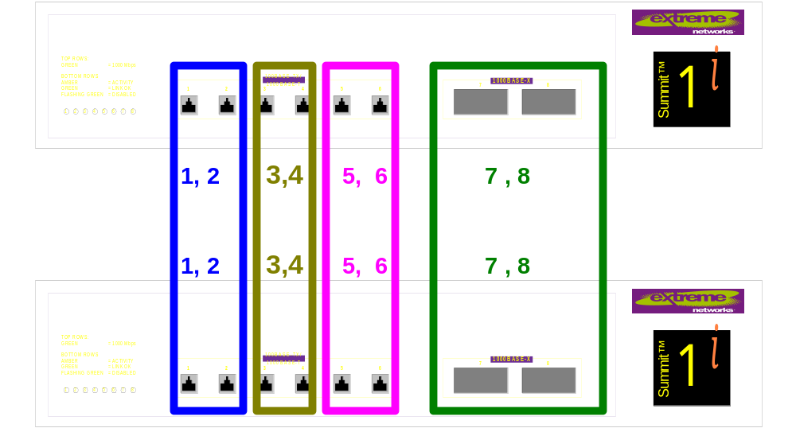
Lab7
Port-Based VLAN & Load Sharing Configuration
Discover and examine the steps to create, configure, and verify port-based VLANs with load sharing.
Making load sharing work between two vlans, using CLI command:
  enable sharing x group x,y algorithm port/round/address
Notes:
Picking up from the previous lab – Lab6, setup the new configuration commands as follows:
1- NEW STEP = Creating load sharing between two switches.
Enable sharing xx ( master port number) Group xx,xx--- algorithm {port base, address base, round robin}
Note = both switches should have same type of algorithm assigned to make load sharing work without any issues.
2- View if the entire configuration on vlan is set right - Show vlan ( vlan name)
3- How to verify load sharing ports. - Show port configuration
4- Also you can see the routes to different switch/s - Show iproutes
Saving configuration you just created to Primary or secondary location
Save configuration primary (or Secondary)
When asked for verification please press key Y
To make sure upon reboot you will be using the save configuration
Use configuration Primary (or Secondary)

Slide 38
Introducing VLAN Tagging
When spanning multiple switches
  What if you have more vlans to configure and no more physical ports to connect between switches?
Notes:
Remember that when you span multiple switches together with same vlans and be able to communicate with the same broadcast domain, you need to physically cable each switch to each other. The ports used should belong to the same vlan (broadcast domain.)
In the example diagram above, let us assume that all 8 ports of the first switch is already connected to all eight ports of the other switch for 8 different vlans. What if you have a 9th vlan to configure – there are no more ports to use!
Also recall that you have learned only to configure PORT-BASED VLANS or also known as untagged vlans.
Your hands are tied.
We will now introduce VLAN TAGGING to solve this problem.

Slide 39
VLAN Tagging
IEEE 802.1Q VLAN specification
A process that inserts a marker (called a tag) into the Ethernet frame.
  The tag contains the identification number of a specific VLAN, called the VLANid.
Allows a single interconnection between switches to carry traffic for multiple VLANs
Configuration is integral to the overall function of the Extreme switch and the switch ability to support VLANs
Notes:
Tagging is a process that inserts a marker (called a tag) into the Ethernet frame. The tag contains the identification number of a specific VLAN, called the VLANid.
NOTE:
The use of 802.1Q tagged packets may lead to the appearance of packets slightly bigger than the current IEEE 802.3/Ethernet maximum of 1,518 bytes. This may affect packet error counters in other devices, and may also lead to connectivity problems if non-802.1Q bridges or routers are placed in the path.
IEEE 802.1Q VLAN specification - is the Ethernet Tagging specification which is the only standard for this technology.
VLAN Tagging is integral in the operation of a Summit switch and its ability to support VLANs.
The switch applies tagging as the data passes through the fabric of the switch.
Allows a single interconnection to carry traffic for multiple VLANs.

Slide 40
VLAN Tagging - Dependencies
Ethernet frame with Tag
Recognized?
Implicit Tagging
  Packets without 802.1Q tags
  Only one implicit tag per port
  Applies to Port-based vlans
Explicit Tagging
  Packets with 802.1Q tags
  Multiple explicit tags per port
  Applies to Tagged vlans
?
Ethernet frame with Tag or No Tag?
Notes:
When a switch receives a packet from a port, or when it has to send a packet out on its port – is the packet carrying a tag upon receipt or will the packet carry a tag going out?
This question can be directly related to this statement – Was the port configured as a tagged or untagged port?
Tagging has two methods of operation. Implicit tagging is used in association to a given port which has an implicit tag value that has been assigned by the switch
Explicit tagging is defined by the reception of an already tagged packet. It explicitly defines itself by having an already populated tag within the MAC header. This tag is what the user/administrator configures.
Remember: A VLAN can only participate in only one Spanning Tree Domain, and a port may not participate in two VLANs from separate spanning trees because STP is blind to vlan membership and tag identification.
Note: ExtremeWare(Vista) will drop an explicitly tagged packet that does not match the defined values for a given port.

Slide 41
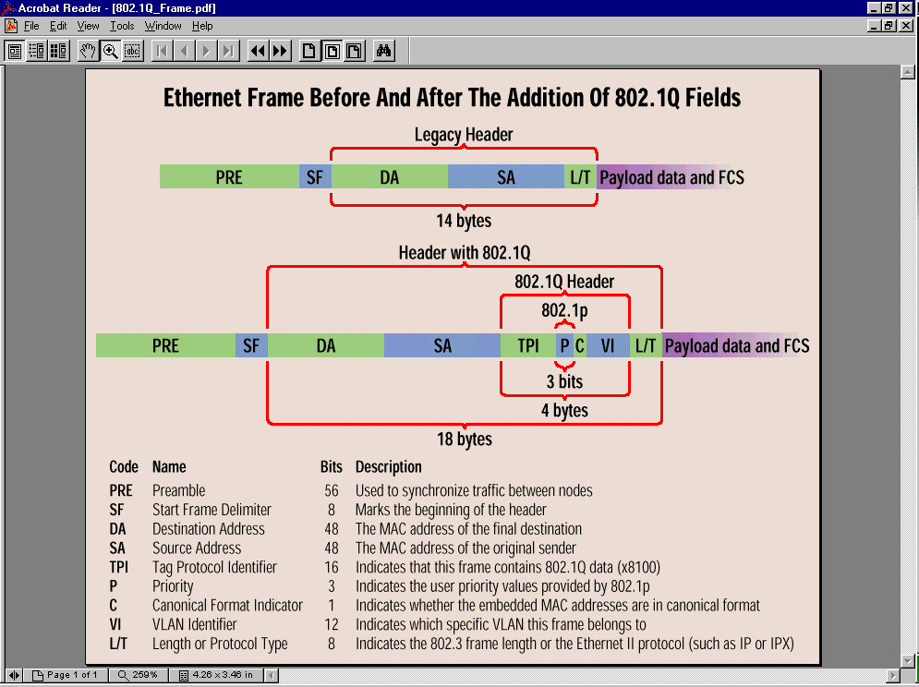
Ethernet Frame –
Before & After Tagging
Notes:
Ethernet Frame Before and After the addition of the 802.1Q fields.
Code Name Bits Description
PRE Preamble 56 Used to synchronize traffic between nodes
SF Start Frame Delimiter 8 Marks the beginning of the header
DA Destination Address 48 The MAC address of the final destination
SA Source Address 48 The MAC address of the original sender
TPI Tag Protocol Identifier 16 Indicates that this frame contains 802.1Q data (x8100)
P Priority 3 Indicates the user priority values provided by 802.1p
C Canonical Format Indicator 1 Indicates whether the embedded MAC addresses are in canonical format
VI VLAN Identifier 12 Indicates which specific VLAN this frame belongs to
L/T Length or Protocol Type 8 Indicates the 802.3 frame length or the protocol

Slide 42
Tagged VLANs on Extreme Switches
Provides for VLANs to span 2 or more switches
  With only a single interconnection between switches
A port can be a member of multiple VLANs
  Only one of the VLANs it belongs to can be a port-based VLAN\
  The rest of the VLANs should be either tagged, protocol-based or MAC-based.
Notes:
Tagging is most commonly used to create VLANs that span switches. The switch-to-switch connections are typically called trunks. Using tags, multiple VLANs can span multiple switches using one or more trunks. In a port-based VLAN, each VLAN requires its own pair of trunk ports. Using tags, multiple VLANs can span two switches with a single trunk.
Another benefit of tagged VLANs is the ability to have a port be a member of multiple VLANs. This is particularly useful if you have a device (such as a server) that must belong to multiple VLANs. The device must have a NIC that supports 802.1Q tagging.
A single port can be a member of only one port-based VLAN. All additional VLAN membership for the port must be accompanied by tags. In addition to configuring the VLAN tag for the port, the server must have a NIC that supports 802.1Q tagging.
Keep in mind that end stations may not recognized tagged frames coming from the Switch port it is connected to. This end workstations will discard this frame because where it expect a Type/Length field, there is a tag value inserted into it.
The diagram shows the BEFORE TAGGING which requires all vlans spanning the switches to have a physical connection and the AFTER TAGGING, with only one physical connection spanning multiple vlans with tags.

Slide 43
Assigning A VLAN Tag
Each VLAN may be assigned an 802.1Q VLAN tag
  Configure the vlan with a tag value (2 - 4094) using the command
    configure vlan <vlan_name> tag <tag value> ⬅new
    Example: config default tag 40
As ports are added to VLAN with tag, you decide whether each port will use tagging for that VLAN
  The CLI command to have a port use tags for a given VLAN is:
    config vlan <name> add port <portlist> tag ⬅new
The switch adds and strips tags on each port based on VLAN and port membership configuration
Notes:
Each VLAN may be assigned an 802.1Q VLAN tag. As ports are added to a VLAN with an 802.1Q tag defined, you decide whether each port will use tagging for that VLAN.
The default mode of the switch is to have all ports assigned to the VLAN named “default” with an 802.1Q VLAN tag (VLANid) of 1 assigned.
Not all ports in the VLAN must be tagged. As traffic from a port is forwarded out of the switch, the switch determines (in real time) if each destination port should use tagged or untagged packet formats for that VLAN. The switch adds and strips tags, as required, by the port configuration for that VLAN.
NOTE:
Packets arriving tagged with a VLANid that is not configured on the switch will be discarded.
Is there a MAC-based VLAN support in this release - not yet.

Slide 44
Configuring Tagged Vlans
First you create a vlan
  create vlan <vlan_name>
Configure an ip address for the VLAN (if required)
  config vlan <vlan_name> ipaddress <ip-address>/<netmask>
Configure the vlan with a tag value (2 - 4094)
  config vlan <vlan_name> tag <tag value>
Configure vlan with member ports as tagged
  config <vlan_name> add ports <port list> tagged
Verify that the ports are now tagged ports
  show <vlan_name>
Notes:
These are the steps that will enable you to configure vlans with tags and configure the vlan with ports that are tagged.
First you create a vlan
create vlan <vlan_name>
Example: create vlan test
Configure the vlan with a tag value (2 - 4094)
configure vlan <vlan_name> tag <tag value> ⬅new
Example: config test tag 100
Configure vlan with member ports as tagged
config <vlan_name> add ports <port list> tagged ⬅new
Example: config test add po 1-2 tagged
Verify that the ports are now Tagged ports
show <vlan_name>
Example: show test

Slide 45
VLAN Configuration Example
First you create a vlan called TEST
  create vlan test
Configure an ip address for the VLAN TEST
  config test ipaddress 10.10.10.1/24
Configure the vlan with a tag value of 100
  config test tag 100
Configure vlan with member ports as tagged
  config test add po 1-2 tagged
Verify that the ports are now tagged ports
  show test
Notes:
This is very important!
This will describe the commands associated with setting up VLANs on the swtich. Configuring a VLAN involves the following step:
1-Create and name the VLAN
2-Assign an IP address and mask (if applicable) to the VLAN, if needed.
NOTE:
Each IP address and mask assigned to a VLAN must represent a unique IP subnet. You cannot configure the same IP subnet on different VLANs
3-Assign a VLANid, if any ports in this VLAN will use a tag.
4-Assign one or more ports to the VLAN
As you add each port to the VLAN, decide if the port will use an 802.1Q tag.

Slide 46
Verify Example – show VLAN test
* Summit1iTx:20 # show test
VLAN Interface[2-204] with name "test" created by user
Tagging: 802.1Q Tag 100
IP: 10.10.10.1/255.255.255.0
STPD: Domain "s0" is not running spanning tree protocol
Protocol: Match all unfiltered protocols.
Loopback: Disable
Rate Shape: Disable
QosProfile:QP1
Ports: 4. (Number of active ports=0)
Untag: 3 4
Tagged: 1 2
* Summit1iTx:21 #

Slide 47
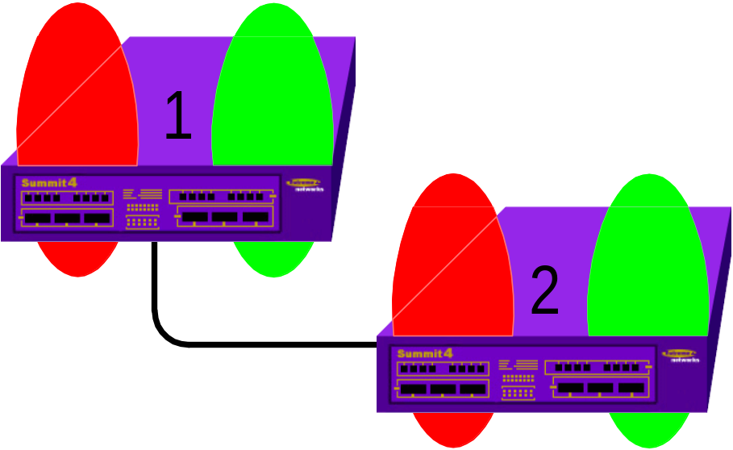
More on Tagging
Multiple VLANs using a single, physical uplink require tags to differentiate the broadcast domains

Slide 48
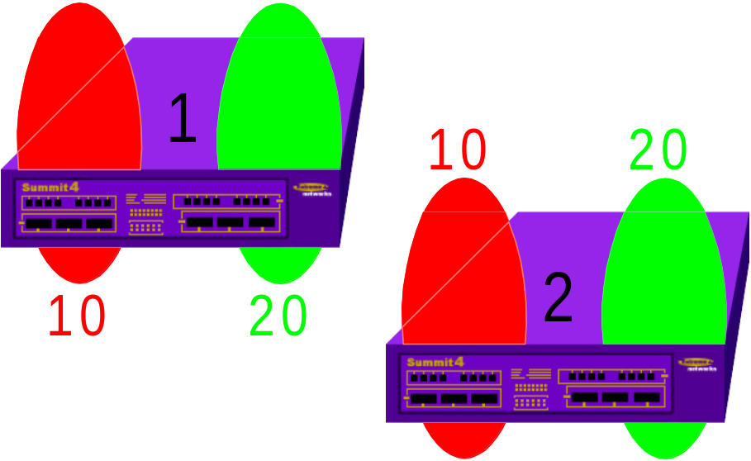


More on Tagging cont…
Tags must match across an uplink for the associated VLANs to be contiguous

Slide 49


More on Tagging cont…
If the tags are mismatched, datagrams will be discarded at the port and the VLANs will remain partitioned

Slide 50
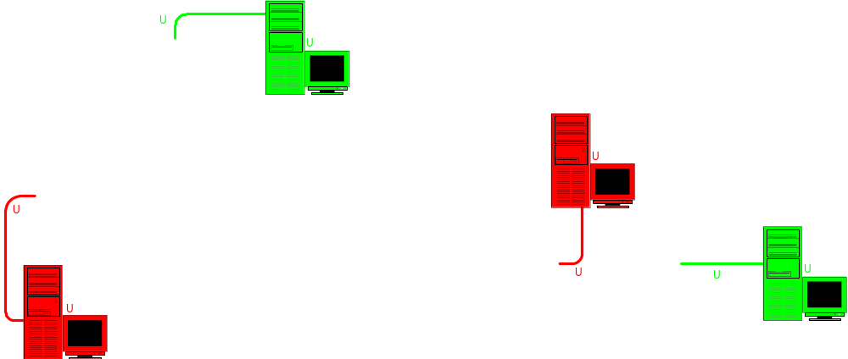
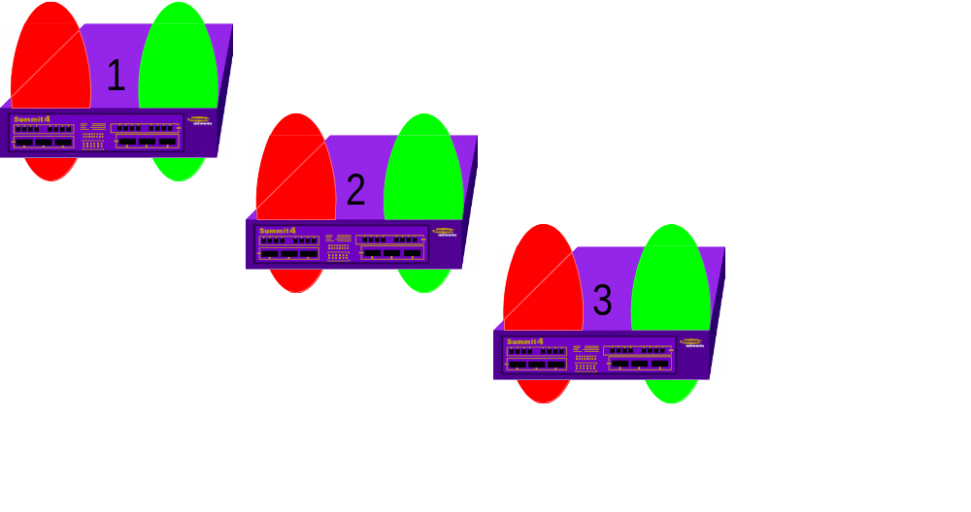
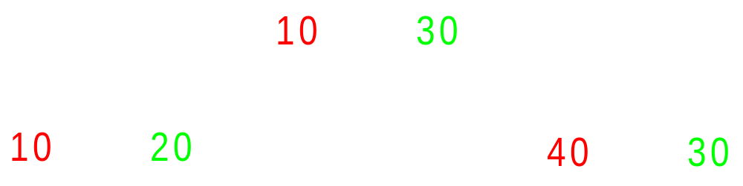



More on Tagging cont…
If the tag values are inconsistent end-to-end, but the port tag memberships are consistent across a link, will the network exhibit continuity across the VLANs?

Slide 51
Lab8
Port-Based VLAN Configuration with Tagging
Discover and examine the steps to create, configure, and verify port-based VLANs with Tags
Making Tagging work between VLANs using CLI command:
  Config Kauai Tag 300
  Config Oahu Tag 400
Notes:
Lab8- continue the configuration using the preceding labs and add new configuration commands as follows:
1- New Step = adding tag to just created vlan
Configure vlan ( vlan name) tag (numeric for tag)
2- Add ports to vlan you just created
Configure vlan ( vlan Name ) add port ( no. of ports-see note)
NOTE =>{ this will be added as untag port}
3- Add ports to vlan with tag capability
Configure vlan ( vlan name) add port ( number of port/s ) tag
4- Also you can see the routes to different switch/s : Show iproutes
5- View if all the configuration on vlan is set right, including tag info
Show vlan ( vlan name)
6- Saving configuration you just created to Primary or secondary location
Save configuration primary ( or Secondary)
When asked for verification please press key Y
7- To make sure upon reboot you will be using the save configuration
Use configuration Primary ( or Secondary)

Slide 52
Protocol-Based VLAN
It enables one to define a protocol filter to be used as the matching criteria to determine if a particular packet belongs to a particular VLAN.
Or use the pre-defined protocol filters on the switch
Green Protocol VLAN
Multiple Incoming Protocols
Blue Protocol VLAN
Red Protocol VLAN
Notes:
This type of VLAN enables filtering by protocol type to match a data stream to a particular VLAN
Protocol-based VLANs enable one to define a packet filter that the switch uses as the matching criteria to determine if a particular packet belongs to a particular VLAN.
They are most often used when network segments contain hosts running multiple protocols, like the example diagram shown, where an ingress port is configured to receive traffic from three different protocol types (e.g., IPX, IP and AppleTalk).

Slide 53
Protocol-Based VLAN
Pre-defined Protocol Filters
IP
IPX
NetBIOS
DECNet
IPX_8022
IPX_SNAP
AppleTalk
Notes:
The following protocol filters are predefined on the switch and can readily be used.
IP
IPX
NetBIOS
DECNet
IPX_8022
IPX_SNAP
AppleTalk

Slide 54
Protocol-Based VLAN
Defining Protocol Filters
Create a protocol filter using CLI command:
  create protocol <protocol_name>
  Example:
    create protocol albert
Configure the protocol filter using CLI command:
  config <protocol_name> add/del <protocol_type> <hex_value>
  Example:
    config albert add etype 8000
Notes:
If necessary, you can define a customized protocol filter based on EtherType. Logical Link Control (LLC), and/or Subnetwork Access Protocol (SNAP). Up to six protocols may be part of a protocol filter.
The following procedures are used to define & configure a customized protocol filter
1-Create a protocol filter using the CLI command
create protocol <protocol_name>
Protocol names can have a maximum of 32 characters
2-Configure the protocol filter using the CLI command:
configure protocol <protocol_name> add <protocol_type> <hex_value>
Supported protocol types include
etype - EtherType
llc - LLC Service Advertising Protocol (SAP)
snap - EtherType inside the IEE SNAP packet encapsulation
Note the maximum number of Protocol-based VLANs protocol filters that can be active and configured for use as of EW 6.1.8 Release Notes are:
15 for I-based products
7 for non-I based products

Slide 55
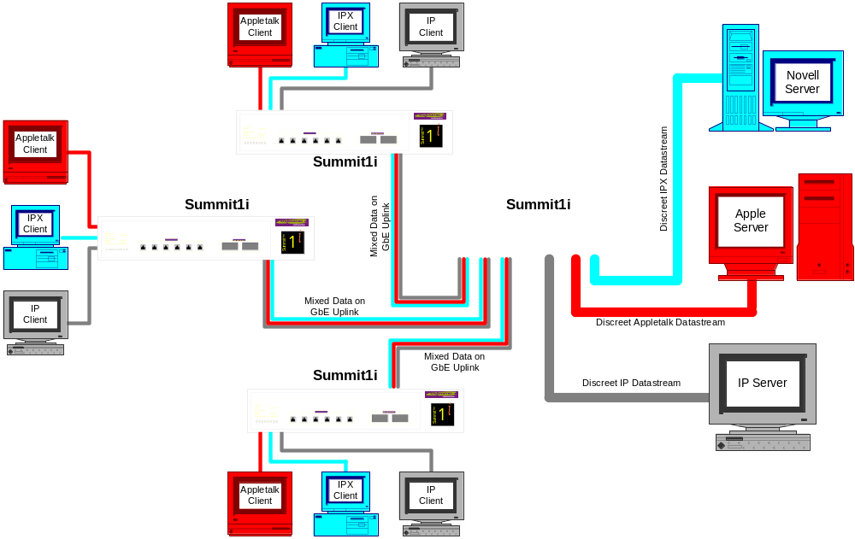
Protocol-based VLAN (L2) Example
Notes:
Example: Protocol-based VLANs in use in an L2 network
In this example, the S7i is the Core switch. On the S1i switches, we created 3 Protocol-based VLAN.
VLAN Blue - discrete IPX datastream
VLAN Red - discrete AppleTalk datastream
VLAN Grey - discrete IP datastream

Slide 56
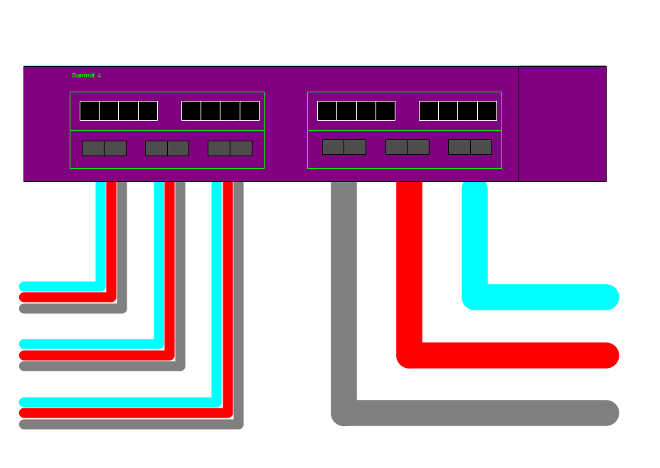
Example (cont.)
Configure 3 Protocol-based VLANs, each with four ports
  all three VLANs will have three ports in common -- those serving the Summit S1i’s at the perimeter
Novell Server
Apple Server
IP Server
Notes:
Continuing with the example presented in the previous slide, focus on the Summit7i at the Core. We will configure 3 Protocol-based VLANs, one for each data stream .
Each VLAN will consist of four ports; 3 of the ports will be connected to the S3s and the remaining one is connected to the server.
Note that in this example, all three VLANs will have three ports in common -- those serving the Summit S1i’s at the perimeter.
To accomplish this, you will create 3 protocol-sensitive VLANs in the S7i. The example commands are shown on the next slide.
Remember in this example:
We are protecting the IP server in the gray VLAN from the broadcasts coming in from the Red and Blue VLANs containing (Novell and AppleTalk Servers).

Slide 57
Example: Summit7i Configuration
create vlan IP_gray
configure vlan IP_gray protocol ip
configure vlan IP_gray add ports 17-20
create vlan Atalk_red
configure vlan Atalk_red protocol appletalk
configure vlan Atalk_red add ports 17-19, 21
create vlan IPX_blue
configure vlan IPX_blue protocol ipx
configure vlan IPX_blue add ports 17-19, 22
Notes:
The CLI commands to configure the S7i is listed above. For each VLAN, you will create the VLAN, configure the VLAN with IP address and add the ports.

Slide 58
Protocol-based VLANs Things to Remember
When a protocol filter is deleted from a VLAN
  VLAN is assigned a protocol filter of NONE
  No traffic is forwarded till a protocol is assigned
Tagged packets take precedence over protocol filters associated with a VLAN
IPX
Ethernet Frame Tagged, IPX
Tag=10
Notes:
Remember, I can only assign one protocol filter to a VLAN. Remember that protocol filter is considered like a tag, I.e. one tag per VLAN.
If a protocol filter is deleted from a VLAN, the VLAN is assigned a protocol filter of none. You can continue to configure the VLAN. However, no traffic is forwarded to the VLAN until a protocol is assigned to it.
Precedence of Tagged Packets over Protocol Filters
If a VLAN is configured to accept tagged packets on a particular port, incoming packets that match the tag configuration take precedence over any protocol filters associated with the VLAN.
Example:
When a packet is received on the port configured with VLAN red with a Tag = 10 and VLAN green with an IPX protocol filter, which will the switch service first? The Tag takes precedence when there is a match.

Slide 59
vMAN Feature vPN Services for Metropolitan Area Networks
Allow “tunneling” of any number of 802.1Q and/or Cisco ISL VLANs into a single VLAN
  that can be switched through an Extreme ethernet infrastructure.
A given vMAN tunnel is completely isolated from other tunnels or VLANs.
Useful in building transparent private networks
  that need point-to-point or point-to-multipoint connectivity across
VLAN tagging methods used within the tunnel
  are transparent to the tunnel.
For the MAN provider
  the tagging numbers and methods used by the customers are transparent to the provider.

Slide 60
Steps to Configure vMAN Tunnel
Modify the 802.1Q Ethertype used by switch to recognize tagged frames
Configure the switch to accept “Jumbo” frames
Create tunnels by creating VLANs and configuring member ports as
  tagged on switch-to-switch ports and
  Untagged on the tunnel’s ingress/egress ports

Slide 61
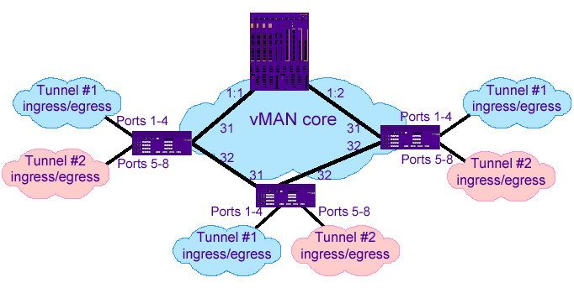
Example vMAN Configuration
Notes:
Depicted above is an example configuration setup with vMANs. Two tunnels are depicted that have ingress/egress ports on each Summit7i.
Note that specific to this configuration, a L1 pr L2 redundancy method would also be employed – like Spanning Tree or ESRP.

Slide 62
Example vMAN Configuration cont…
For all the Summit7i's that are shown, the configuration is:
  config dot1q ethertype 9100
  enable jumbo-frame ports 31,32
  config jumbo-frame size 1530
  create vlan Tunnel1
  config vlan Tunnel1 tag 50
  config vlan Tunnel1 add port 1-4 untag
  config vlan Tunnel1 add port 31,32 tagged
  create vlan Tunnel2
  config vlan Tunnel2 tag 60
  config vlan Tunnel2 add port 5-8 untag
  create vlan Tunnel2 add port 31,32 tagged

Slide 63
Example vMAN Configuration cont…
On the BlackDiamond:
  config dot1q ethertype 9100
  enable jumbo-frame ports all
  config jumbo-frame size 1530 create vlan tunnel1
  config vlan tunnel1 tag 50
  config vlan tunnel1 add port 1:1-1:2 tagged
  create vlan tunnel2
  config vlan tunnel2 tag 60
  config vlan tunnel2 add port 1:1-1:2 tagged
For this configuration,
  Layer 1 or Layer 2 redundancy method would also be employed, e.g. Spanning Tree or other ExtremeWare offers.

Slide 64
Lab9 – vMAN Familiarization
Optional????

Slide 65
MAC-Based VLANs
Allow physical ports to be mapped to a VLAN based on the source MAC address learned in the FDB.
Allows you to designate a set of ports that have their VLAN membership dynamically determined by the MAC address of the end stations that plugs into the physical port.
You may configure the source MAC address-to-VLAN mapping either offline, or dynamically on the switch.
Notes:
MAC-Based VLANs allow physical ports to be mapped to a VLAN based on the source MAC address learned in the FDB.
This feature allows you to designate a set of ports that have their VLAN membership dynamically determined by the MAC address of the end stations that plugs into the physical port.
You may configure the source MAC address-to-VLAN mapping either offline, or dynamically on the switch.
For example:
You can use this for a roaming user who wishes to connect to a network from a conference room.
Say he belongs to accounting. In each conference room, the user can plug into one of the designated ports on the switch and is mapped to the ACCOUNTING vlan.
All the benefits of being always in the ACCOUNTING vlan in terms of QoS, routing, and protocol support are still maintained.

Slide 66
MAC-Based VLANs Guidelines
A port can only have endstation/host connected
Groups are used as a security measure to allow a MAC address to enter into a VLAN only when the group mapping matches the port mapping.
The group “any” if equivalent to group “0”
  Ports configured as “any” allow any MAC address to be assigned to a VLAN, regardless of group association.
Partial configurations of the MAC to VLAN database can be downloaded to the switch using the timed download configuration feature
Notes:
When using the MAC-to-VLAN mapping, consider the following guidelines.
A port can only accept connections from an endstation/host and should not be connected to a L2 repeater/hub device. Doing so will cause certain addresses to not be mapped to their respective VLAN if they are not correctly configured in the MAC-VLAN configuration database.
Groups are used as a security measure to allow a MAC address to enter into a VLAN only when the group mapping matches the port mapping.
The group “any” if equivalent to group “0”
Ports configured as “any” allow any MAC address to be assigned to a VLAN, regardless of group association.
Partial configurations of the MAC to VLAN database can be downloaded to the switch using the timed download configuration feature

Slide 67
MAC-Based VLAN Limitations
Member ports must first be removed from any static VLANs
MAC-to-VLAN mapping can only be associated with VLANs that exist on the switch
A MAC address cannot be configured to associate with more than 1 VLAN
  If done, the MAC address is associated with most recent VLAN entry in the MAC-to-VLAN database
One client per physical port is the feature intent
Notes:
The following list above indicates the limitations of MAC-based VLANs.
Member ports must first be removed from any static VLANs
The MAC-to-VLAN mapping can only be associated with VLANs that exist on the switch
A MAC address cannot be configured to associate with more than 1 VLAN
If done, the MAC address is associated with most recent VLAN entry in the MAC-to-VLAN database
One client per physical port is the feature intent.
Once a client MAC address has successfully registered, the VLAN association remains until the port connection is dropped or the FDB entry ages out.

Slide 68
MAC-Based VLAN Configuration
Create the MAC-based VLAN/s
Enable a port to use the MAC-based VLAN algorithm
  enable mac-vlan mac-group [any | <group_number>] port <portlist>
Associate/add MAC address to a MAC-based VLAN
  config mac-vlan add mac-address [any | <mac_address>] mac-group [any | <group_number>] vlan <name>
Display the MAC-based VLAN configuration and MAC address database content
  show mac-vlan {configuration | database}

Slide 69
MAC-Based VLAN Example
Create three vlans: finance, sales, and support
  create vlan finance
  create vlan sales
  create vlan support
A single MAC address is associated per VLAN
  MAC address 00:00:00:00:00:02
    has a group number of “any” or “0” associated with it allowing it to be plugged into any port that is in MacVlanDiscover mode

Slide 70
MAC-Based VLANs Timed Configuration Download
Allow centralized control of MAC-Based VLANs over multiple switches
Allows the download of incremental configuration files from a primary or secondary server at specified time intervals
  Automatic configuration file download upon switch reboot
Configurable in 24 hour intervals

Slide 71
MAC-Based VLANs Timed Configuration Download CLI commands
To configure the primary or secondary server and file name:
  config download server [primary | secondary] <host_name/ip> <filename>
To download timed interval configuration:
  download configuration every <hour (0-23)> <minute (0-59)>
To display timed download information:
  show switch

Slide 72
Lab10 – MAC-Based VLAN Configuration
Learn to configure MAC-Based VLANs
Includes configuring a timed configuration download

Slide 73
Types of VLANs – A review
Port-based (Untagged) Vlan
802.1Q Tagged Vlan
Protocol-based Vlan
vMANs
MAC-based Vlan (MAC address)
Notes:
VLANs can be created on the switch according to the following criteria.
Port-based (Untagged) Vlan
802.1Q Tagged Vlan
Protocol-based Vlan
Ethernet, LLC SAP, or LLC/SNAP Ethernet protocol type
Treated like a Tagged Vlan
MAC-based Vlan (MAC address)
A combination of any of the above
You need to provide a physical connection between the switches when you configure Vlans, if you want each one of the Vlan, you need to be connected physically, even though they belong to the same broadcast domains.
In order for a port to participate in more than 1 VLAN, you have to isolate the traffic - reason being is that there are several different types of traffic.
How do you know the type of traffic going through is red or blue?
This introduces us to going into TAGGING that allows us to carry traffic into multiple broadcast domains going to 4-61.

Slide 74
VLANs - A Summary
All ports default to VLAN named “default” and are untagged
  config default del ports all
Use VLAN names consistently across the entire network
Assign one or more ports to the VLAN
  Decide if the port will use 802.1Q tag as you add them
3000 VLANs Maximum now supported
A port may be a member of multiple vlans
  Only one of the VLAN can be untagged
  Rest can be a combination of other VLAN types
Notes:
Any number of VLANs can exist on a physical port (64 stated max), but only one may be port based (untagged).
In other words, a port can simultaneously be a member of one port-based VLAN and multiple protocol or tag-based VLANs.
Traffic exiting the switch will follow the configured tag.
An error message will result if you attempt to add an untagged VLAN to a port with an existing untagged VLAN.
Note, default is the initial owner of all ports. To assign ports to a newly created VLAN, it is necessary to remove the ports from the default VLAN.

Slide 75
Module Summary
Describe the switch ports, parameters its configuring using the CLI commands
Define the load sharing feature and its benefits
Define VLAN in an overview
Describe VLAN tagging and its advantages
Distinguish between VLAN types - port-based, tagged, protocol-based, MAC-based and vMANs
Describe how to configure Vlans Port Load Sharing using CLI commands
Perform Lab Exercises
Review

Slide 76
This page intentionally left blank.

